Slide 1

On Cloud Wine
Erik Moore
Ziye Zhang
Kelly Agnew
Gautami Edara
Vaibhav Vishal
Matt Lundrigan
Zack Tan
Jiahua Liang
Notes:
Project titled On Cloud Wine

Slide 2
AGENDA
01.
03.
02.
04.
Project Overview
Modeling
Background and Problem Statement
Overview of model testing and results
Data
Conclusion
Acquisition, Exploration and Pre-processing
Next steps
Notes:
1. Talk about the background and a few use cases for our project
2. Discuss the data we will be using and how we process it
3. Present some of our preliminary models and and results
4. Discuss where we intend to take this project from here

Slide 3
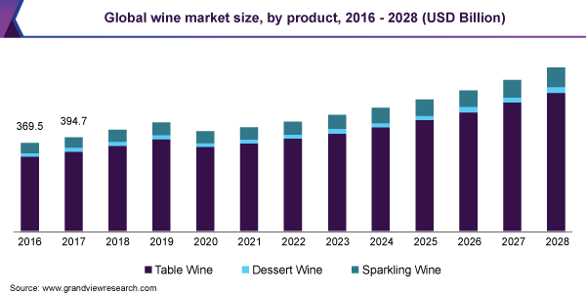
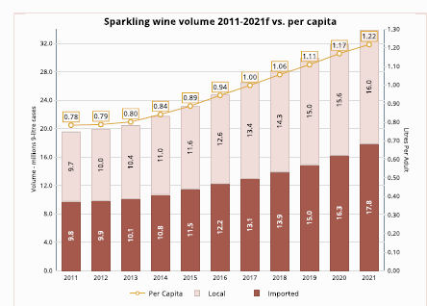

Background
Global wine market valued at US$420 billion in 2020
Expected to expand at CAGR of 6.4% from 2021 to 2028
COVID-19 leading to increased wine consumption
Notes:
Why we chose to do our project on wine
Wine industry is a big one, with a market valuation of US$420 Billion in 2020
Predicted to grow at average annual rate of 6.4% from 2021 to 2028.
Refer to graph on the top-right
Historical trends (bottom-right) also shows increasing consumption of wine over the years
Study shown that Covid-19 pandemic also leads to increased wine consumption as more households are buying wine to enjoy with their loved ones
CAGR - Compound annual growth rate
3rd point source: https://www.mordorintelligence.com/industry-reports/wine-market

Slide 4


Use Cases & Stakeholders
Vineyards
Factors that affect wine price
Decide what grapes to cultivate
Country / Province
Variety (e.g. Pinot Noir)
Customers
Recommendation System
Selecting a bottle of wine
Attributes from sommelier descriptions
At preferred price point
Retailers
Inventory Management
Decide which wines to market
Causal Analysis
Interplay of various factors (e.g. origin with vintage)
Notes:
Aiming to predict price of wine (Regression problem)
3 use cases for 3 stakeholders in the wine industry
3 use cases
Vineyards : Factors that contribute to the price of wine WITHIN location and climate requirements
For example, Cab Franc and Vidal in Niagara region - which is more profitable to grow to produce what types of wine and to meet market demand
Customers : Recommendation system to find characteristics associated with wines of different price points
Retailers : Causal inference to look at how strongly certain factors (such as origin) influence control/treatment factors (i.e. vintage) in determining the target (price).
As an example, perhaps wines from Italy may not result in much variance in wine prices regardless of the wine’s vintage.

Slide 5
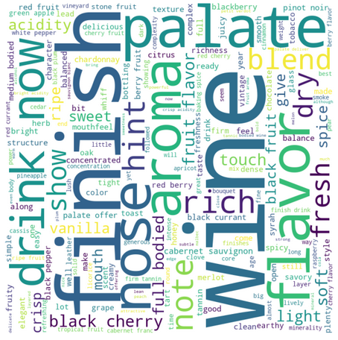
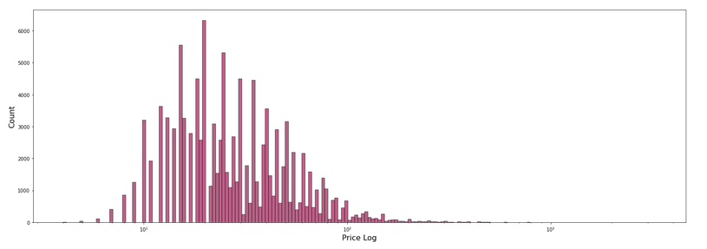
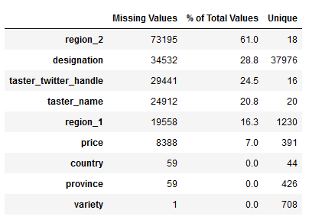
Data Exploration
Dataset: Wine Enthusiast Kaggle Dataset
Notes:
To achieve this goal and to start learning more about the factors influencing wine pricing, we used a Kaggle dataset that was scraped from winemag.com and contains information about roughly 130’000 wines. After removing any instances where entire rows of data were identical, we were left with about 120’000 unique wines. This dataset contained information about the location where the wine was made, the grapes used (variety), the description, the master sommelier who reviewed the wine, and the overall score the wine received. On first glance at the distribution of prices in our dataset, the vast majority of the wines are below $100. For a better visualization of the distribution, we are showing it on a log scale. Another thing to note here is the number of missing values and unique values in some of the columns, especially for many of the location based variables. These were all things to consider when performing data pre-processing.
Notes
Target var: Price
Discuss the distribution of this var within the dataset using a log scale graph
Wordcloud to visualize the description field
@analyst team - Anything else you want to include here?

Slide 6
Data Pre-Processing
Raw Data
Drop Nulls (Price)
Description
Method: NLP binary vectorizer using key wine attributes
Province, Variety, Region 1
Method: Kept top 20 by frequency, mapped rest to ‘Other’, OH encoded
Full Pipeline
Title
Method: Extract year, impute mean
Taster
Method: Kept top 5 by frequency, mapped rest to ‘Other’, OH encoded
Country
Method: Kept top 10 by frequency, mapped rest to ‘Other’, OH encoded
Region 2
Method: Binary missing value indicator
Pre-Processed Data
Shape: (78058, 262)
Min-max Scaling
Z-Standardization
Notes:
After data exploration, we split the data into a train and test set, and dropped any instances where our target variable (price) was null. The team thought it would be interesting to pull some of the attributes and key characteristics of the wine in the prediction model, so we identified a list of aroma and non-aroma characteristics to identify from the description for each wine. The ‘title’ contained information that was available in other columns in the dataset, with the exception of the year that the wine was produced (the vintage). This was extracted as its own column. Any of the columns with a very high cardinality had their top most frequent values kept, and the rest mapped to ‘Other’. Finally, as region 2 had over 60% of its data missing, instead of using that column outright, we created a binary indicator for whether or not the data was missing for that column. When the pre-processing was all said and done, the training set had about 78000 rows and 260 columns. We also tried both min-max scaling and z-score standardization on the first few basic models we trained, and found that z-score standardization performed better across the board.

Slide 7


Modeling Exploration
Model | RMSE | MAE | Fitting Time | Hyperparameters
Linear Regression | 1.111e+12 | 6.171e+11 | 2 Seconds | N/A
Decision Tree | 39.35 | 16.56 | 6 Seconds | Criterion:squared error, min_samples_split:2
Random Forest | 30.85 | 12.81 | ~5 Minutes | Max_features:auto, n_estimators:100
Support Vector Machine | 33.51 | 13.42 | ~3 Hours | kernel:linear
Gradient Boosting | 29.70 | 13.33 | ~2 Minutes | Criterion:friedman_mse,
MLP | 36.49 | 21.55 | ~5 Minutes | max_iter=500, hideen_layer_sizes:(100,
Predictor Selection:
As of now, using all predictors except price, sommelier description and winery name
Notes:
Presenters:
Kelly
Talking Points:
We trained multiple types of regressors on the training data set (~80,000 observations) using a Standard Scaling pipeline from our cleaning process.
The results shown here are for one run with each model, generally default hyperparameters. Of note: SVR takes a very long time, and was still outperformed by GB, MLP, RF.
We took the best three models and have implemented GridSearchCV to obtain optimal hyperparameters (Still Ongoing)
Once the grid searches are all complete, we will train the final model and make predictions on wines
In the meantime, we brought in Causal ML to give us some more insights about the features
Model
Document and present the type of model.
Supervised, unsupervised, semi-supervised, reinforcement,
Classification (binary, multi-class, multi-label, multi-output), regression
Train many models
Compare/contrast based on success metrics: RMSE/MAE
Modeling process - Fine-tuning
GridSearchCV
Most significant vars for each algo
Content
What models did we explore?
Why did we go with this model in the end?
Explain the hyperparameters
Visualization (potentially shared with results slide):
Table with each model, optimal hyperparameters, results (RMSE/MAE)
Notes
State RMSE/MAE results and briefly discuss
We were thinking to have a table of models - why each was selected, and results (if any)
For things we’re still trying, we can list but just state
Hyperparameters - Which ones apply and any optimal ones?
For ensemble methods: criterion=how we measure quality of the split, min_samples=minimum number of samples required to split an internal node

Slide 8
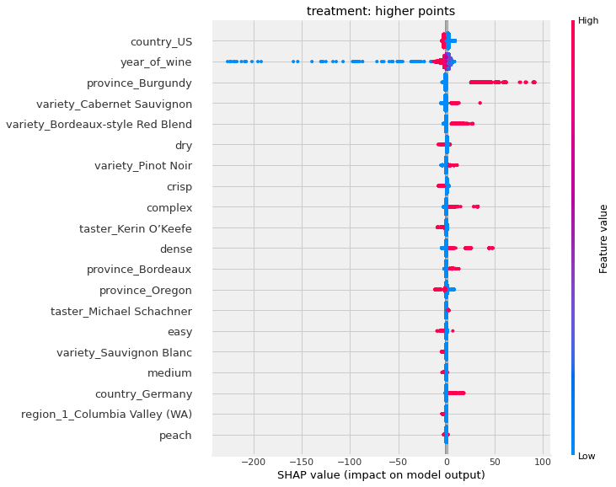
Causal Inference
Treatment:
points: higher (treat), lower (control)
year_of_wine: later (treat), earlier (control)
Outcome: price
Control features: all other features (excluding the treatment)
Package: Causal ML
Methods:
S-Learner with LGBMRegressor
T-Learner with XGBTRegressor
Calculations:
Average Treatment Effect (ATE)
points: 19.01 (T-Learner)
year_of_wine: -4.22 (T-Learner)
Individual Treatment Effect (ITE)
Feature Importance for predicting ITE
SHAP values for control features
Notes:
Presenters:
Kelly
Causal Inference Script:
We are interesting in investigating the causal effect of the two most important features of our predictive models, the points and the year of wine. We applied two meta-learner methods from the causal ML package to calculate both the average and individual treatment effects, the feature importance for the causal inference models, and the SHAP values for the control features. The positive average treatment effect of points suggests that wines with higher points tend to have higher prices on average while the negative average treatment effect of year_of_wine suggests that wines of later years tend to have lower price. On the right, we also have the SHAP value plot for the treatment “point” where we can investigate how the control features affect the treatment effect prediction. The vertical axis shows the 20 most important control features for the causal model in an descending order of their importance. The horizontal axis shows the SHAP values of the control features of each observation. If we take the control feature “year_of_wine” as an example, there are quite a few of wines (the blue dots) with lower year_of_wine value, which means they are older, that have negative impact on the treatment effect estimate. This suggests that for those older wines, the treatment effect of having a higher point is not significant, which means for those older wines, having higher points or lower points doesn’t matter too much for their prices. We can do the same analysis for other control features as well.
Other insights:
Burgundy: For wines from this region, the difference between the higher point wines and lower point wines (aka our treatment effect) is positive, meaning that the treatment effect is significant here. We can also interpret this to mean that there is high disparity in wines in this region with regards to point values & subsequent prices
Managerial Insight: If you want to make a lot of money, sell wine with fake labels from the year 1700 and people will buy it regardless of the reviews your wine gets from wine critics
Notes
@jack write your content here and we’ll figure out how to structure it
Good for retailers to see

Slide 9


Next Steps
May improve model performance
TF-IDF Vectorization
Take into account users preferences for wine attributes and price range
Recommendation System

Slide 10
Thank you

Slide 11
Appendix

Slide 12
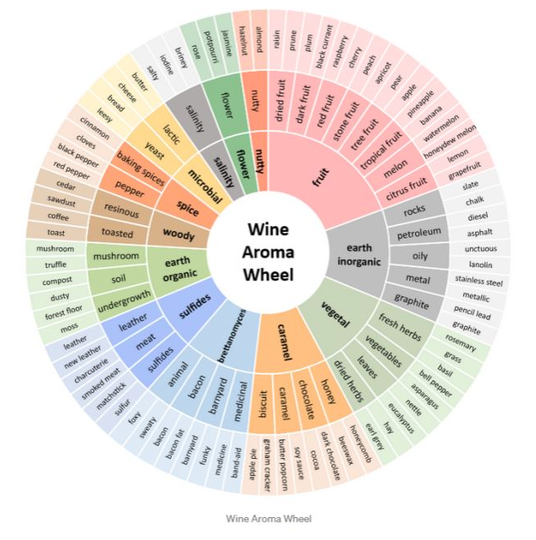
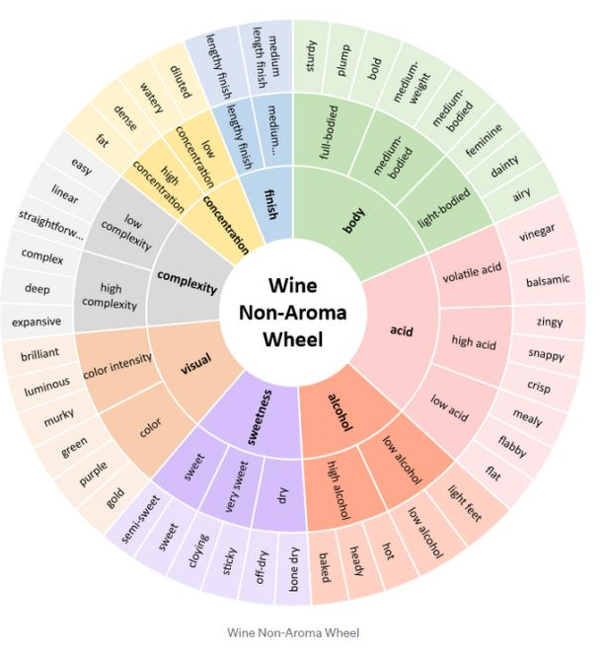
Key Wine Attributes
Back
Notes:
Team members’ names, github ids, repo name

Slide 13
Team Information and Github IDs
Github Repo: https://github.com/ZCTan762/enterprise_datascience_project/
Team Members ; Github IDs ; Student IDs
Product Owner/Project Manager:
Zhi Cheng (Zack) Tan ; @ZCTan762 ; 261016413
Matthew Lundrigan ; @mattlundrigan ; 261049155
Data Analyst:
Ziye Zhang ; @ZZYActSci ; 260766101
Erik Moore ; @moorerik ; 260766013
Gautami Edara ; @gautamiedara ; 260973353
Data Scientist:
Vaibhav Vishal ; @vvaibhav11 ; 260984038
Kelly Agnew ; @kelly-agnew ; 260607478
Jiahua Liang ; @Jhliang3 ; 260711529

